Slide 1
Grandhub
Virtual Events & Webinars
Betsy Xu
Business Dvelopment Manager
Oct 2024

Slide 2
Contents
Tech 101: Mastering Digital Tools for Grandparents
Grandparent-Grandchild Bonding Activities
Health and Wellness Webinars for Seniors
Financial Literacy for Grandparents
Storytelling Circles: Sharing Life Stories
Hobby Workshops and Interest Groups
Grandparents Day Celebration Event
Trivia Nights and Games for Brain Health
Cultural Exchange: Virtual Travel and Exploration
Intergenerational Storytelling Competitions
Celebrating Milestones Together

Slide 3
Introduction
Hosting Virtual Events and Webinars is a fantastic way to engage your community of grandparents on an online platform. Virtual gatherings can offer opportunities for education, entertainment, and social interaction, all of which are highly valuable to your target audience.

Slide 4
01.
Tech 101: Mastering Digital Tools for Grandparents

Slide 5
Our Online Platform
Purpose: Help grandparents become more comfortable with technology.
Content: Offer beginner-friendly workshops on topics such as using smartphones, social media platforms (e.g., Facebook, Instagram), video calling (Zoom, FaceTime), and staying safe online.
Interactive Elements: Include Q&A sessions where participants can ask questions or troubleshoot tech issues.
Follow-up: Offer downloadable guides or one-on-one tech support for attendees who need extra help.

Slide 6
Mission
Vision
Grandhub is the most friendly platform to get the old together
Grandhub is to provide the old with connection and support

Slide 7
02.
Grandparent-Grandchild Bonding Activities

Slide 8
Main goal and how to achieve
Purpose: Encourage interaction between grandparents and their grandchildren using the online platform.
Content: Host interactive sessions where grandparents and their grandkids can participate in activities like:
Virtual storytelling sessions where they read books to each other.
Crafting workshops where they create projects together.
Virtual cooking or baking classes where both generations can follow along with recipes.
Engagement: Encourage families to upload pictures or videos of their completed projects or meals, creating a community sharing experience.

Slide 9
Health and Wellness Webinars for Seniors
03.

Slide 10

Main Webinars
Purpose: Provide valuable health information to help grandparents stay healthy and active.
Content: Partner with health professionals to discuss topics such as:
Managing chronic conditions like diabetes, arthritis, or heart disease.
Gentle exercises for seniors (e.g., chair yoga, stretching, light cardio).
Mental health and wellness tips, such as dealing with loneliness, stress, or anxiety.
Follow-up: Offer downloadable exercise routines or healthy meal plans, and link participants to mental health resources.

Slide 11
Financial Literacy for Grandparents
04.

Slide 12
Financial Literacy
Purpose: Offer financial education tailored to the needs of older adults.
Content: Host webinars on topics like:
Planning for retirement and managing retirement savings.
Understanding social security and pension benefits.
Estate planning and wills.
Avoiding online scams and protecting financial information.
Expert Guests: Invite financial advisors or legal experts to present and answer questions.

Slide 13
Storytelling Circles: Sharing Life Stories
05.

Slide 14
Storytelling Circles
Purpose: Build community by allowing grandparents to share their life experiences.
Content: Create a virtual space where grandparents can share stories about their youth, significant life events, or memories from raising their children. This can also be a great opportunity to record these stories for their family history.
Engagement: Make this an interactive event where attendees can ask questions or share related stories. You can also have a "theme" for each session, such as "My favorite childhood memory" or "Life lessons I want to pass on."

Slide 15
Hobby Workshops and Interest Groups
06.

Slide 16
Hobby Workshops and Interest Groups
Purpose: Create an engaging, social atmosphere around hobbies and interests.
Content: Offer virtual classes or meetups based on different hobbies that your members enjoy. Ideas include:
Gardening tips and tricks.
Knitting and crochet groups.
Photography classes tailored for smartphone users.
Music appreciation or book clubs.
Birdwatching meetups where participants share sightings from their area.
Community Engagement: Set up breakout rooms for smaller group discussions, allowing participants to connect with others who share their passions.

Slide 17
Grandparents Day Celebration Event
07.

Slide 18
Grandparents Day Celebration Event
Purpose: Celebrate and honor grandparents with a special virtual event.
Content: Host a fun virtual celebration on National Grandparents Day, complete with:
Live musical performances from local artists or talented grandchildren.
A “virtual awards ceremony” recognizing inspiring members of your platform.
Family trivia games where grandparents team up with their grandchildren.
Storytelling or memory-sharing sessions about what it means to be a grandparent.
Special Features: Allow attendees to invite their children or grandchildren to participate, turning it into an intergenerational event.

Slide 19
Grandparents Day Celebration Event
08.

Slide 20
Grandparents Day Celebration Event
Purpose: Promote cognitive health through fun, engaging activities.
Content: Host virtual trivia nights where grandparents can test their knowledge on a variety of topics, such as history, music, or general knowledge. Other brain-boosting activities could include:
Virtual bingo games with small prizes.
Online crossword or puzzle-solving challenges.
Prize Incentives: Offer platform-related rewards, like free premium access or gift cards for winners.

Slide 21
Cultural Exchange: Virtual Travel and Exploration
09.

Slide 22
Quality Improvement Measures
Purpose: Offer virtual “trips” to different parts of the world, encouraging cultural exploration.
Content: Partner with travel bloggers, historians, or local guides to provide virtual tours of famous cities, museums, or natural wonders.
Feature themes such as “Touring Ancient Rome” or “Exploring the National Parks of the USA.”
Include live Q&A sessions with the host.
Interactive Elements: Encourage participants to share their own travel experiences and favorite destinations.

Slide 23
Intergenerational Storytelling Competitions
10.

Slide 24
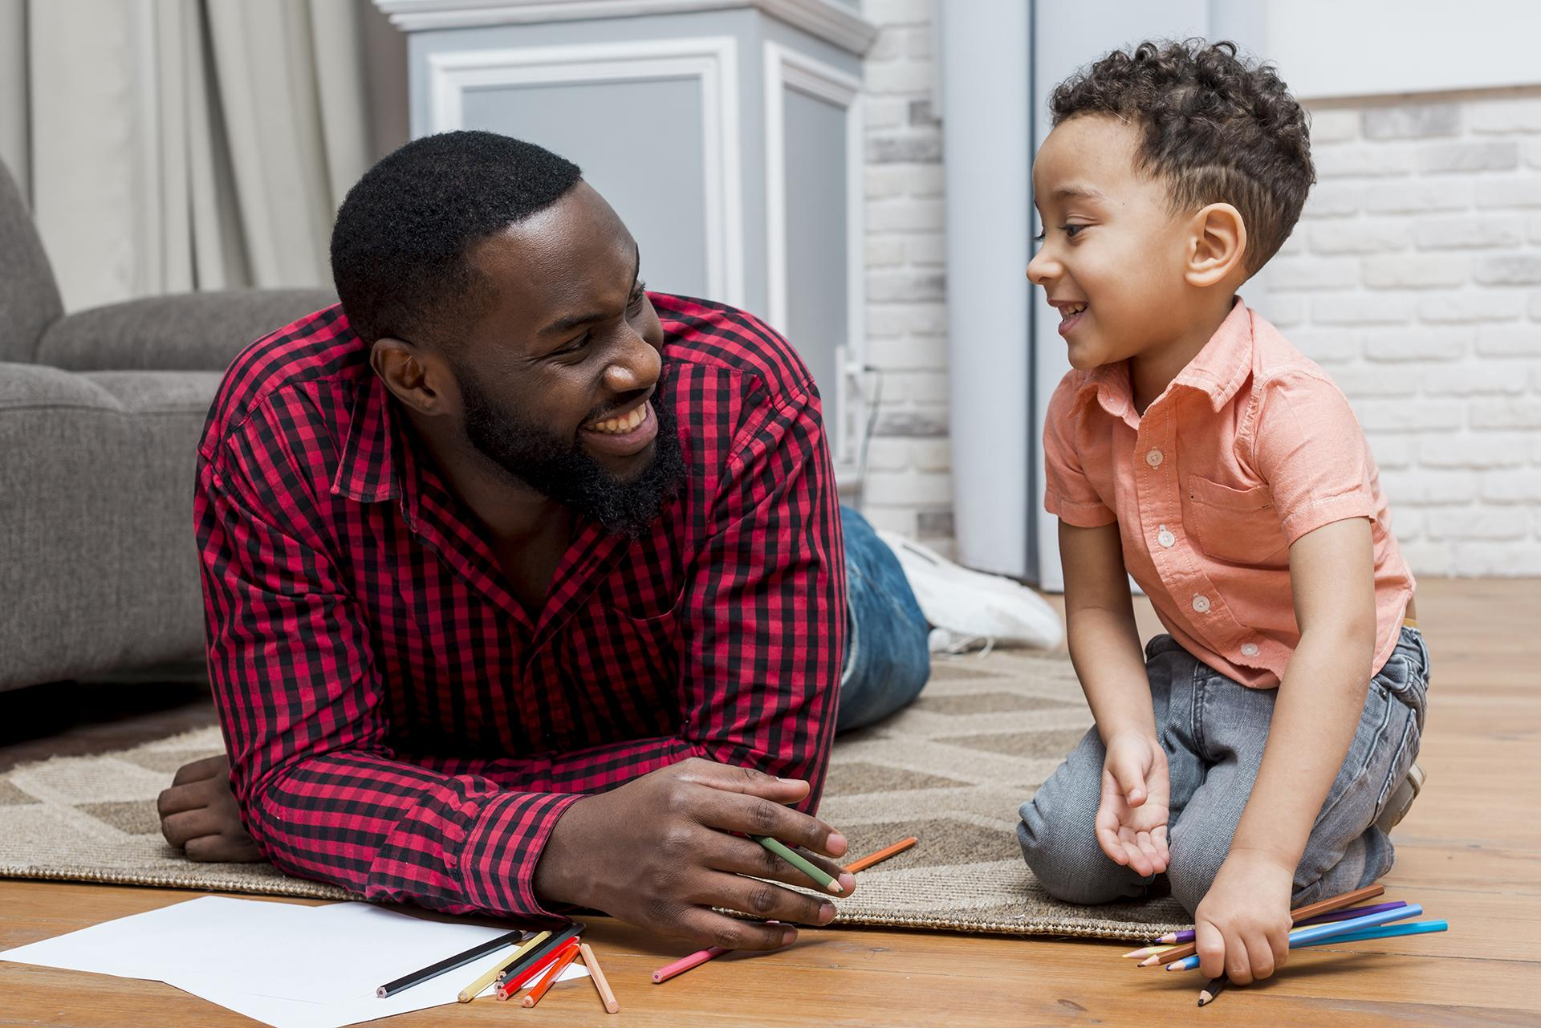
Intergenerational Storytelling Competitions
Purpose: Foster storytelling between grandparents and their grandchildren.
Content: Organize a virtual storytelling competition where grandchildren and grandparents co-create stories and present them. Categories could include:
Fictional stories that incorporate lessons or family values.
Retelling of important family history or shared memories.
Engagement: Have participants vote on the best stories, with winners receiving rewards like free platform membership or special features.

Slide 25
Celebrating Milestones Together
11.

Slide 26
Celebrating Milestones Together
Purpose: Recognize important life milestones for your platform's members, from birthdays to anniversaries.
Content: Host monthly or quarterly events celebrating member birthdays, anniversaries, or special achievements. Create a sense of community by:
Featuring special shout-outs during the event.
Offering virtual cakes or decorations (fun, interactive features).
Creating a slideshow of participant pictures.
Interactive Elements: Allow other members to leave congratulatory messages or join in on group singing of “Happy Birthday.”

Slide 27
Thanks!
Do you have any questions?
betsyxu@synergysolution.co.uk
+44 07713 347367
Please keep this slide for attribution

